Slide 1
Predicting Insurance Costs with a Decision Tree
GROUP 5 · REGRESSION MINI PROJECT
Decision Tree Regression on 1,337 real insurance customers
Raghad · Ruba · Daniyah · Omar
Notes:
Presenter: [name]. Introduce the team and the topic: we were asked to apply Decision Tree Regression to predict yearly insurance expenses. Say that the talk covers the problem, how the algorithm works, what the data showed, the model, and the results.

Slide 2
How much will a customer cost next year?
THE PROBLEM
Insurance companies must set a price before any medical bills arrive. Price too low and they lose money. Price too high and customers leave.
Yearly bills in our data range from
$1,122
Our goal: predict a customer’s yearly medical bill from six simple facts about them.
to $63,770
age
sex
BMI
children
smoker
region
About 57 times more for the most expensive customer than the cheapest.
Group 5 · Decision Tree Regression
02
Notes:
Presenter: [name]. Explain the business problem in plain words: the price is set before the bills exist, so the company needs a good estimate. The spread is huge, from about $1,100 to almost $64,000 a year, so guessing one average for everyone would be very wrong. Our job is to predict the bill from six facts.

Slide 3
Six facts in, one bill out
THE DATA
Column | Type | Example | Role
age | number | 19 | input
sex | category | female | input
bmi | number | 27.9 | input
children | number | 0 | input
smoker | category | yes | input
region | category | southwest | input
expenses | dollars | 16,884.92 | target
1,338
customers in the raw file
0
missing values
1
duplicate row removed
20%
smokers (274 of 1,338)
Source: Kaggle, noordeen/insurance-premium-prediction
03
Notes:
Presenter: [name]. Walk through the columns. Three are numbers, three are categories, and expenses is the target we predict. The data is clean: no missing values and only one duplicate row. Only about one in five customers smokes, which matters later because smokers are the expensive group.

Slide 4
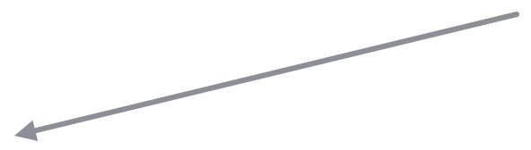
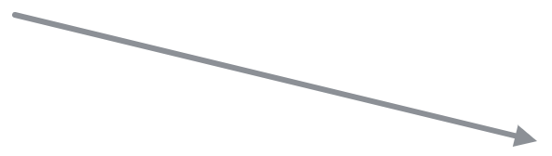
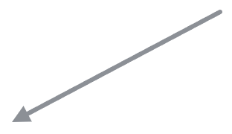
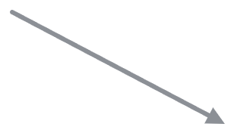
A tree asks yes or no questions
HOW DECISION TREE REGRESSION WORKS
Each answer sends a customer left or right. At the bottom, the prediction is the average bill of the training customers in that group.
Smoker?
No
Yes
Age ≤ 42.5?
BMI ≤ 30.1?
Yes
No
Yes
No
Non-smokers, age 42 or under · 484 people
Non-smokers, age 43 or over · 371 people
Smokers, BMI 30.1 or under · 109 people
Smokers, BMI over 30.1 · 105 people
$5,519
$12,385
$21,337
$41,308
First two levels of our trained tree. The full model goes 5 levels deep.
04
Notes:
Presenter: [name]. This is the core idea. A decision tree is like a game of 20 questions. Our tree’s first question is: does the customer smoke? Non-smokers are then split by age, smokers by BMI. When the questions stop, the customer sits in a group, and the prediction is simply the average bill of the training customers in that group. These are the real numbers from the first two levels of our tree; the full model asks up to five questions.

Slide 5
How the tree picks each question
HOW DECISION TREE REGRESSION WORKS
It tries every feature and every cut point, then keeps the split that makes the bills inside each group most alike.
smoker
59.9% · chosen
age ≤ 42.5
7.9%
bmi ≤ 29.75
3.8%
children ≤ 1.5
1.2%
sex
0.4%
Share of the bill variation removed by the best first split on each feature (1,069 training customers).
Error removed = spread of bills before the split − weighted spread of the two groups after it (squared error)
Group 5 · Decision Tree Regression
05
Notes:
Presenter: [name]. How does the tree choose its questions? At each step it tests every feature and every possible cut point, and measures how much the spread of bills (the squared error) drops. Asking about smoking removes about 60% of the variation in one question. Age removes only 8%, BMI 4%. So smoking becomes the first question. Then the tree repeats the same search inside each group. This is called a greedy search: it picks the best question at each step.

Slide 6
Smokers pay about 4.7 times more
WHAT THE DATA SHOWS
Non-smokers
$7,346
Smokers
$34,456
Median yearly bill per group
Coded as 0 or 1, smoking has the strongest link with the bill: correlation 0.79, compared with 0.30 for age and 0.20 for BMI.
EDA · Group 5 · Decision Tree Regression
06
Notes:
Presenter: Raghad. This is the biggest finding in the data. The middle smoker pays about $34,000 a year; the middle non-smoker about $7,300. That is 4.7 times more. Smoking is text in the raw data, so it does not show up in a normal correlation heatmap; once we code it as 0 or 1, its correlation with the bill is 0.79, much stronger than age or BMI. Careful wording: this shows smokers pay more, not proof that smoking causes it.

Slide 7
Preparing the data
PREPROCESSING
Step 1
Step 2
Step 3
No step 4
Remove duplicates
Encode yes / no
One-hot region
No scaling
One identical row removed: 1,338 rows become 1,337.
sex and smoker become 0 or 1, so the model can read them.
Four 0 or 1 columns, one per region. Coding regions 0 to 3 would invent an order.
A tree compares one value with a cut point, so units never change the split.
Before
female
yes
southwest
After
sex 0
smoker 1
northeast 0
northwest 0
southeast 0
southwest 1
Preprocessing · Group 5 · Decision Tree Regression
07
Notes:
Presenter: Ruba. The data had no missing values, so there was nothing to fill in. We removed one duplicate row. scikit-learn needs numbers, so sex and smoker became 0 or 1. Region has four options, so we used one-hot encoding: one yes/no column per region. If we coded regions as 0, 1, 2, 3, the tree could ask “region ≤ 1.5?”, which pretends regions have an order. We did not scale anything, because a tree only compares one feature with a cut point; changing units moves the cut point but not the groups.

Slide 8
Training the model
MODEL TRAINING
1,069 training customers (80%)
268 test (20%)
The model learns only from the training customers. The test customers stay hidden until evaluation, like an exam it has never seen.
Setting | Value | What it means
max_depth | 5 | At most 5 questions in a row
min_samples_split | 10 | A group needs at least 10 customers to be split again
min_samples_leaf | 5 | Every final group keeps at least 5 customers
random_state | 42 | Same split and same tree on every run
scikit-learn DecisionTreeRegressor · train_test_split(test_size=0.2, random_state=42)
08
Notes:
Presenter: Daniyah. We split the 1,337 customers into 80% for training (1,069) and 20% for testing (268). The model never sees the test customers while learning, so their score shows how it handles new people. The settings limit how big the tree can grow: at most 5 questions, a group needs 10 customers to be split, and every final group keeps at least 5 customers. These limits stop the tree from memorising individual customers. random_state=42 makes the results the same every time we run it.

Slide 9
Results on 268 unseen customers
MODEL EVALUATION
MAE
RMSE
$2,609
$4,390
Average miss per customer, in dollars
Also in dollars, but big misses count more
R²
MSE
0.895
19.27 M
Explains about 90% of the variation in bills
In dollars squared, so no $ sign; used to get RMSE
Evaluation · Group 5 · Decision Tree Regression
09
Notes:
Presenter: Omar. These are measured on the 268 test customers the model never saw. MAE: on average, our prediction is off by about $2,600. RMSE is also in dollars but punishes big mistakes more; it is higher than MAE, which tells us a few customers have large errors. R²: the model explains about 90% of the variation in insurance costs. MSE is the average squared error, so its unit is dollars squared; we mainly use it to get RMSE. Interpretation: most predictions are close, a few are far off. Half of all predictions are within about $1,540; only 17 of 268 are off by more than $10,000, all predicted too low, mostly non-smokers with unusually high bills that the data cannot explain (no medical history). Train R² 0.866 vs test 0.895: close, so no overfitting. Do not call R² “accuracy”. If asked why the numbers look big: the target is in plain dollars; in thousands of dollars the same model shows MAE 2.6 and RMSE 4.4, and R² stays 0.895 because it has no units.

Slide 10
What the model learned
KEY INSIGHTS
smoker
69%
BMI
17%
age
12%
children
1%
sex, region
under 1%
This matches the EDA: smoking first, then BMI for smokers and age for non-smokers. Sex and region barely matter.
Share of the tree’s total error reduction from each feature (model.feature_importances_)
10
Notes:
Presenter: Omar. Feature importance tells us how much each feature helped the tree reduce its error. Smoking alone accounts for 69%. BMI is second at 17% and age third at 12%. Children, sex and region contribute almost nothing. This agrees with what we saw in the EDA. Interesting detail: age has a higher correlation with the bill than BMI (0.30 vs 0.20), but BMI ranks higher here because it splits the smokers, where bills differ by tens of thousands of dollars.

Slide 11
What we found
CONCLUSION
Insight
Performance
Limits and next steps
Smoking drives cost the most
BMI matters mainly for smokers
Age raises cost steadily
Off by about $2,600 on average
Explains about 90% of the variation
No overfitting at depth 5
No medical history in the data
Tune depth with GridSearchCV
Compare with Random Forest
A simple, explainable tree captured the main cost drivers and predicts yearly bills within about $2,600 on average.
Group 5 · Decision Tree Regression
11
Notes:
Presenter: Omar (or [name]). Sum up in three parts. Insight: smoking is the biggest driver, BMI matters mainly for smokers, and age raises cost steadily; the EDA and the model agree on this. Performance: about $2,600 average error and R² of 0.895 on unseen customers, with no sign of overfitting. Limits: the data has no medical history, so some expensive customers cannot be explained, the predictions come in steps, and we used one random split. Next steps: tune the depth with cross-validation (GridSearchCV) and compare with a Random Forest, which averages many trees.

